Slide 1
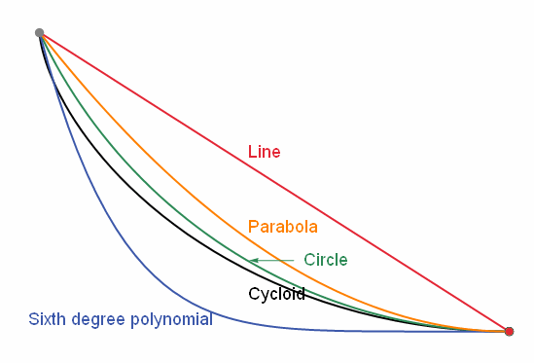
The Brachistochrone Problem
Thomas Nguyen¹
¹Departments of Physics & Astronomy, The University of Arizona, Tucson, AZ

Slide 2
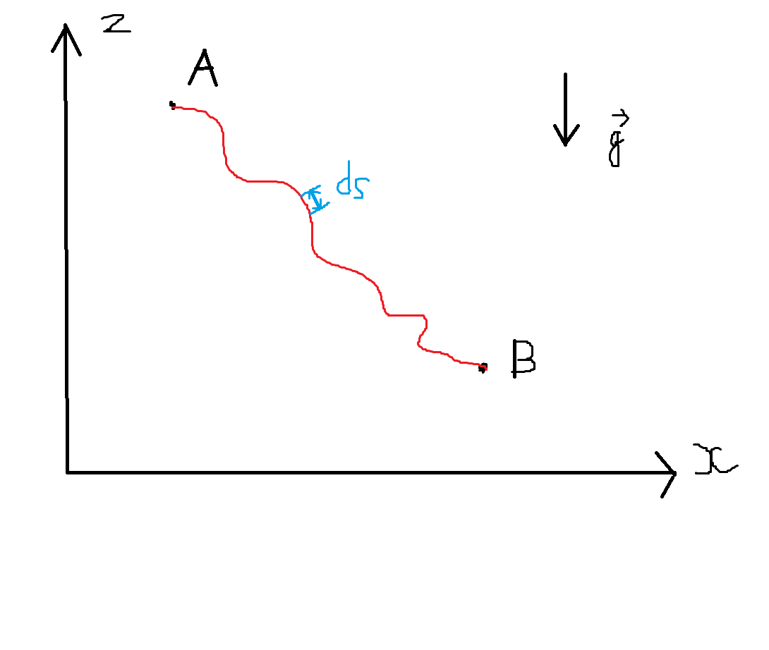
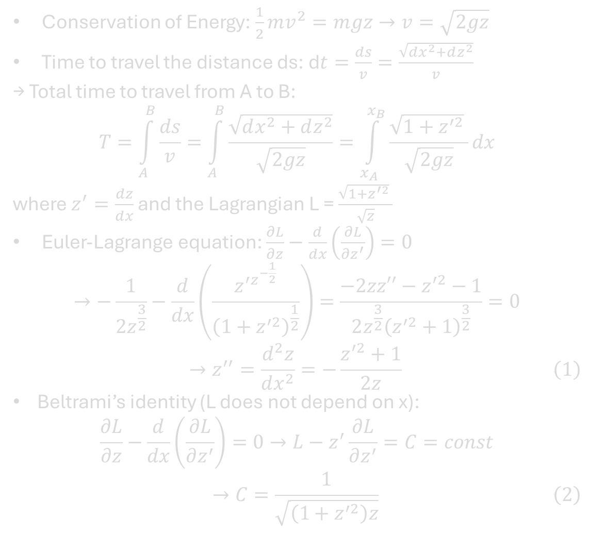
Introduction
Conservation of Energy: $\frac{1}{2}mv^{2}=mgz→v=\sqrt{2gz}$
Time to travel the distance ds: d$t=\frac{ds}{v}=\frac{\sqrt{dx^{2}+dz^{2}}}{v}$
→ Total time to travel from A to B:
$$T=\int_{A}^{B}{\frac{ds}{v}}=\int_{A}^{B}{\frac{\sqrt{dx^{2}+dz^{2}}}{\sqrt{2gz}}}=\int_{x_{A}}^{x_{B}}{\frac{\sqrt{1+z^{′2}} }{\sqrt{2gz}}dx}$$
where $z^{′}=\frac{dz}{dx}$ and the Lagrangian L = $\frac{\sqrt{1+z^{′2}} }{\sqrt{z}}$
Euler-Lagrange equation: $\frac{∂L}{∂z}−\frac{d}{dx}\left(\frac{∂L}{∂z^{′}}\right)=0$
$$→−\frac{1}{{2z}^{\frac{3}{2}}}−\frac{d}{dx}\left(\frac{z^{′z^{−\frac{1}{2}}}}{{\left(1+z^{′2}\right)}^{\frac{1}{2}}}\right)=\frac{−2zz′′−z^{′2}−1}{2z^{\frac{3}{2}}{\left(z^{′2}+1\right)}^{\frac{3}{2}}}=0$$
$$\begin{aligned}→z^{′′}=\frac{d^{2}z}{dx^{2}}=−\frac{z^{′2}+1}{2z}\#\left(1\right)\end{aligned}$$
Beltrami’s identity (L does not depend on x):
$$\frac{∂L}{∂z}−\frac{d}{dx}\left(\frac{∂L}{∂z^{′}}\right)=0→L−z^{′}\frac{∂L}{∂z^{′}}=C=const$$
$$\begin{aligned}→C=\frac{1}{\sqrt{\left(1+z^{′2}\right)z}}\#\left(2\right)\end{aligned}$$

Slide 3
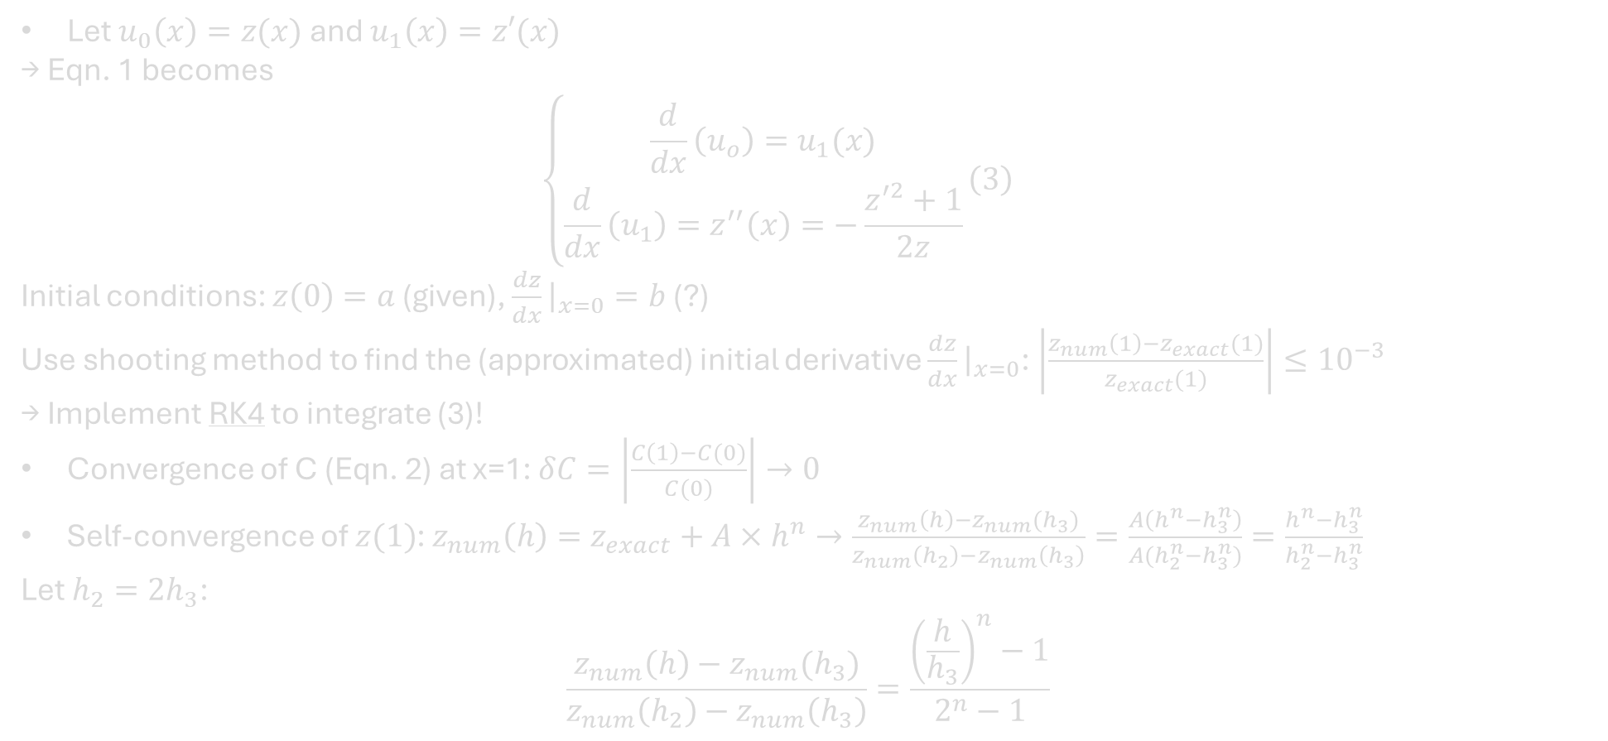
Methodology
Let $u_{0}\left(x\right)=z(x)$ and $u_{1}\left(x\right)=z′(x)$
→ Eqn. 1 becomes
  $$\begin{aligned}\left\{\begin{aligned}\frac{d}{dx}\left(u_{o}\right)=u_{1}(x) \\ \frac{d}{dx}\left(u_{1}\right)=z^{′′}\left(x\right)=−\frac{z^{′2}+1}{2z}\end{aligned}\right.\#\left(3\right)\end{aligned}$$
Initial conditions: $z\left(0\right)=a$ (given), $\frac{dz}{dx}{\left.​\right|}_{x=0}=b$ (?)
Use shooting method to find the (approximated) initial derivative $\frac{dz}{dx}{\left.​\right|}_{x=0}$: $\left|\frac{z_{num}\left(1\right)−z_{exact}(1)}{z_{exact}(1)}\right|≤{10}^{−3}$
→ Implement RK4 to integrate (3)!
Convergence of C (Eqn. 2) at x=1: $δC=\left|\frac{C\left(1\right)−C(0)}{C(0)}\right|→0$
Self-convergence of $z(1)$: $z_{num}\left(h\right)=z_{exact}+A×h^{n}→\frac{z_{num}\left(h\right)−z_{num}(h_{3})}{z_{num}\left(h_{2}\right)−z_{num}\left(h_{3}\right)}=\frac{A\left(h^{n}−h_{3}^{n}\right)}{A(h_{2}^{n}−h_{3}^{n})}=\frac{h^{n}−h_{3}^{n}}{h_{2}^{n}−h_{3}^{n}}$
Let $h_{2}=2h_{3}$:
$$\frac{z_{num}\left(h\right)−z_{num}(h_{3})}{z_{num}\left(h_{2}\right)−z_{num}\left(h_{3}\right)}=\frac{{\left(\frac{h}{h_{3}}\right)}^{n}−1}{2^{n}−1}$$

Slide 4
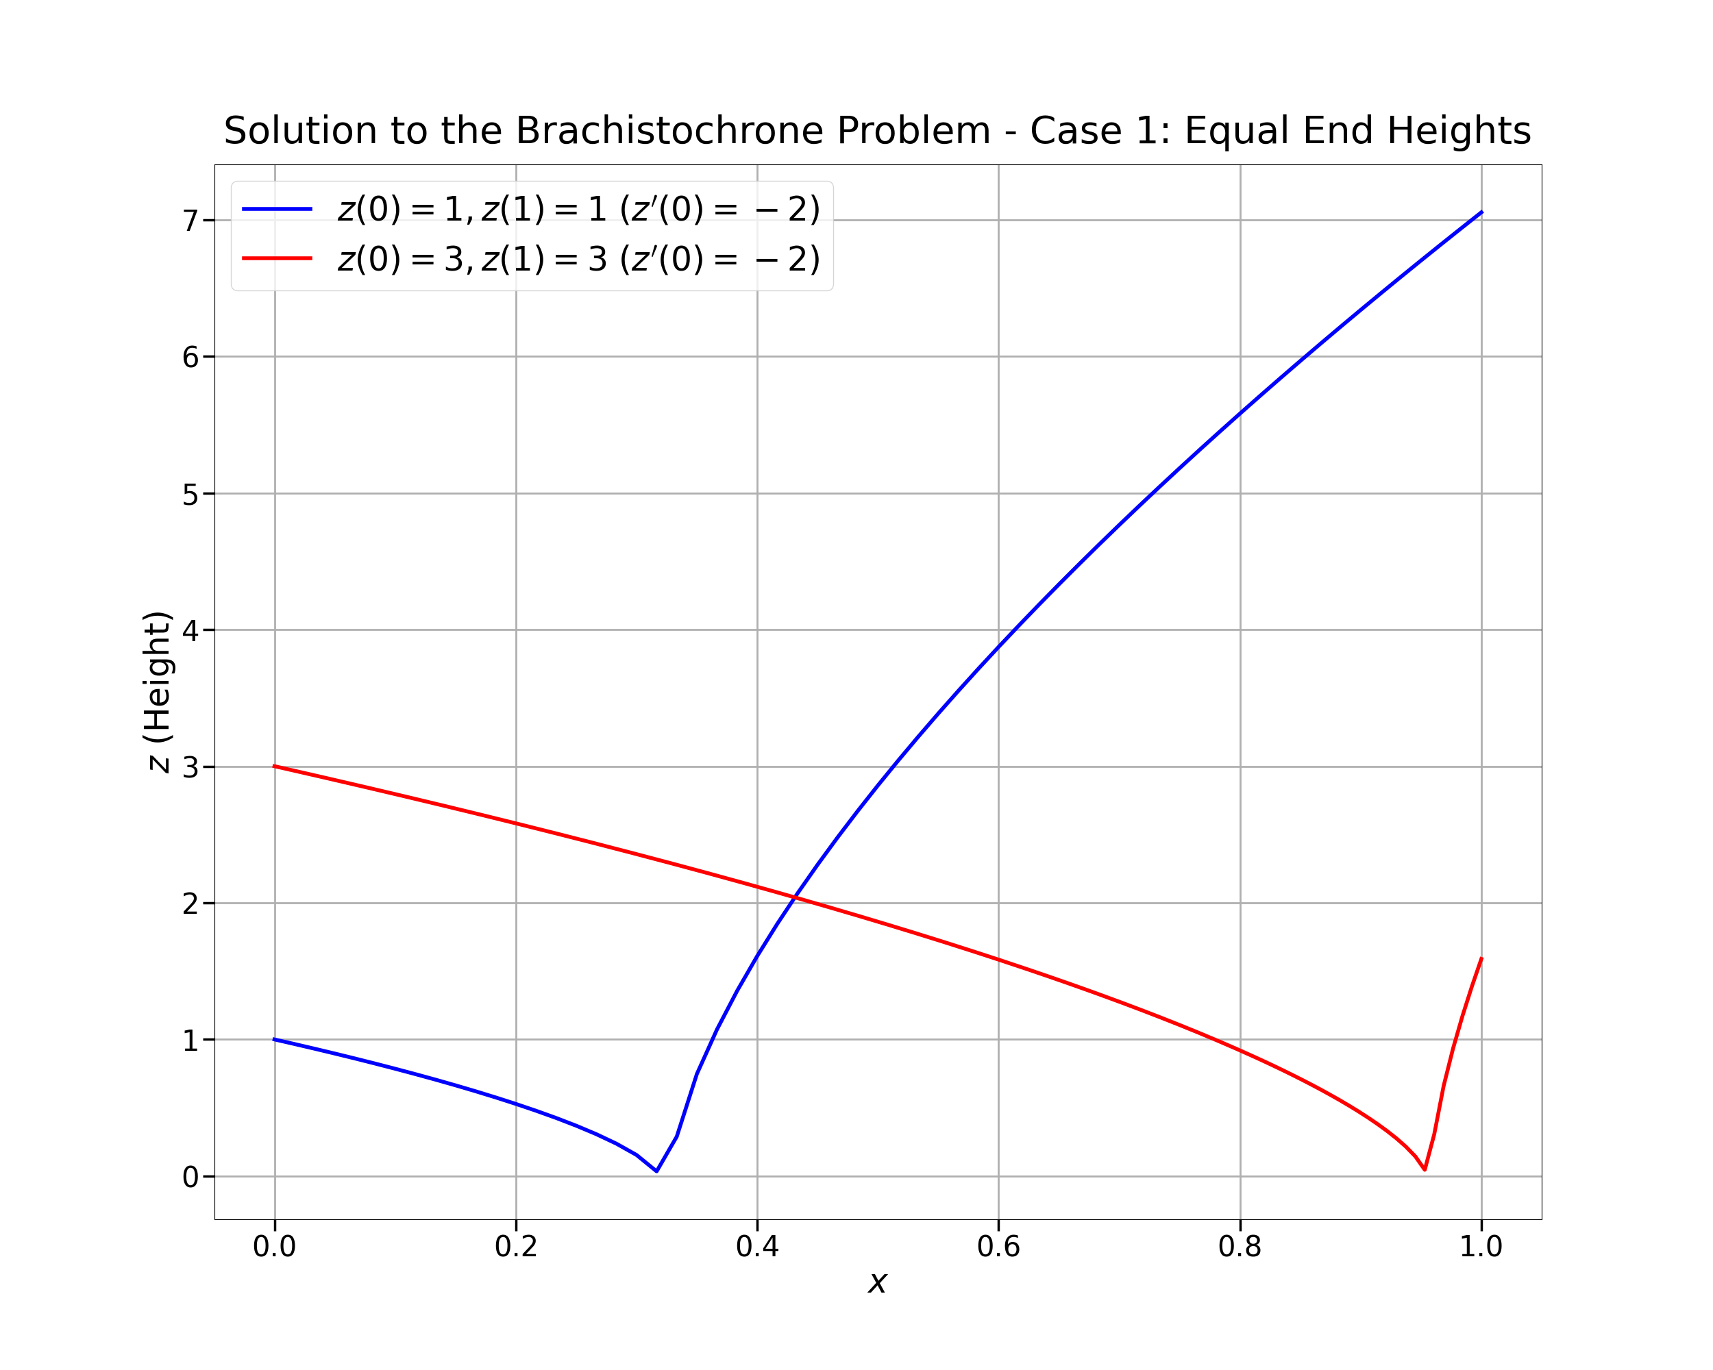
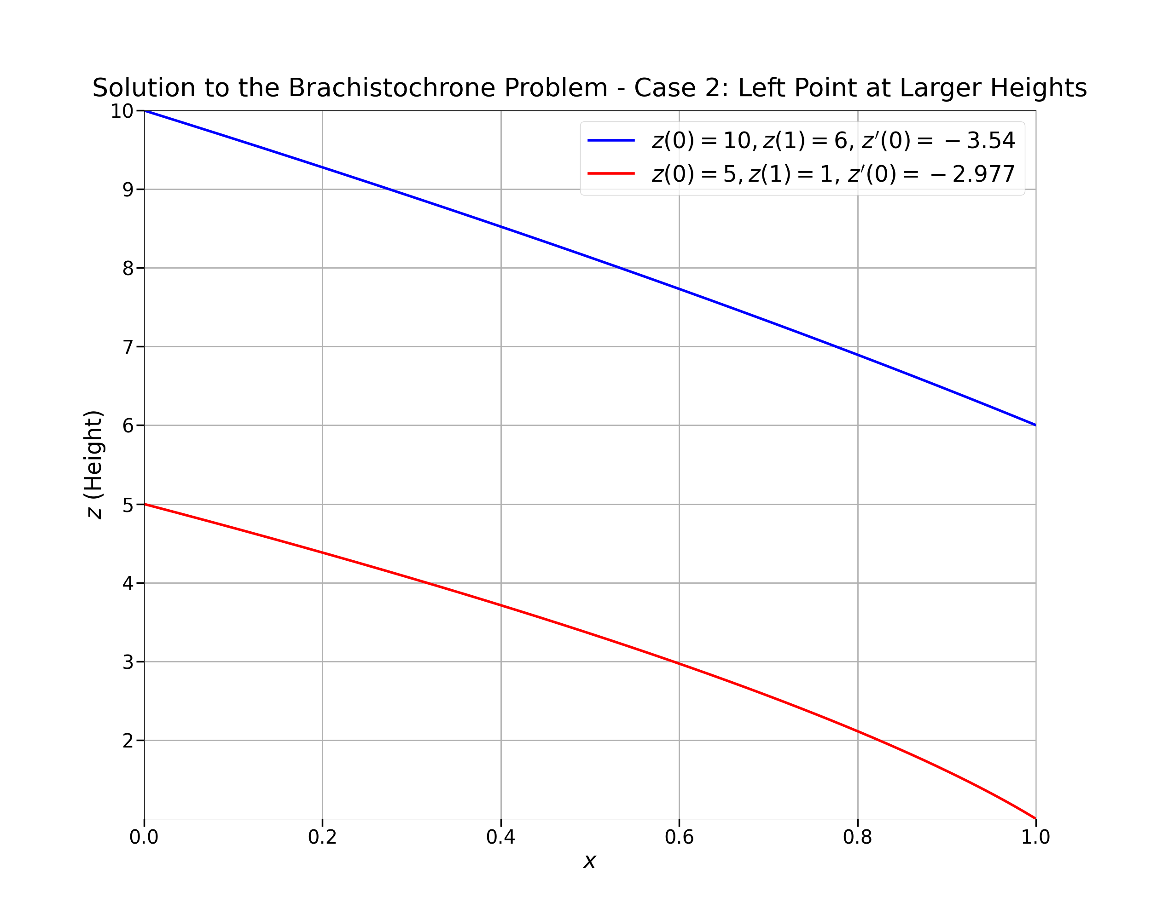
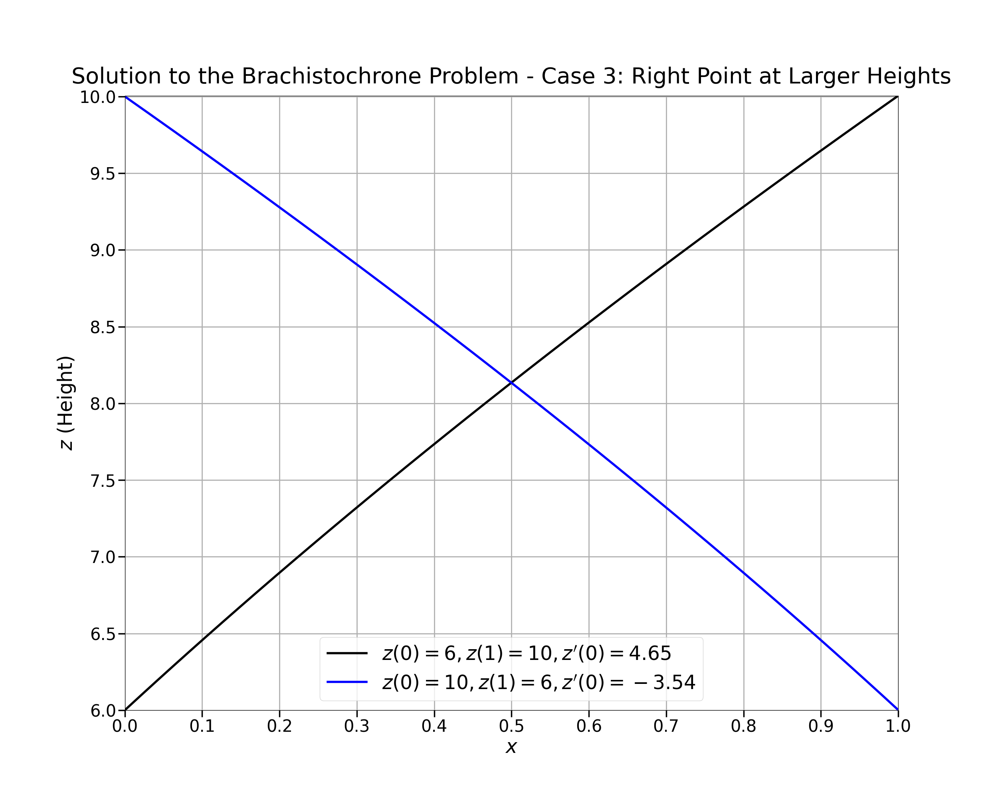
(Preliminary) Results

Slide 5
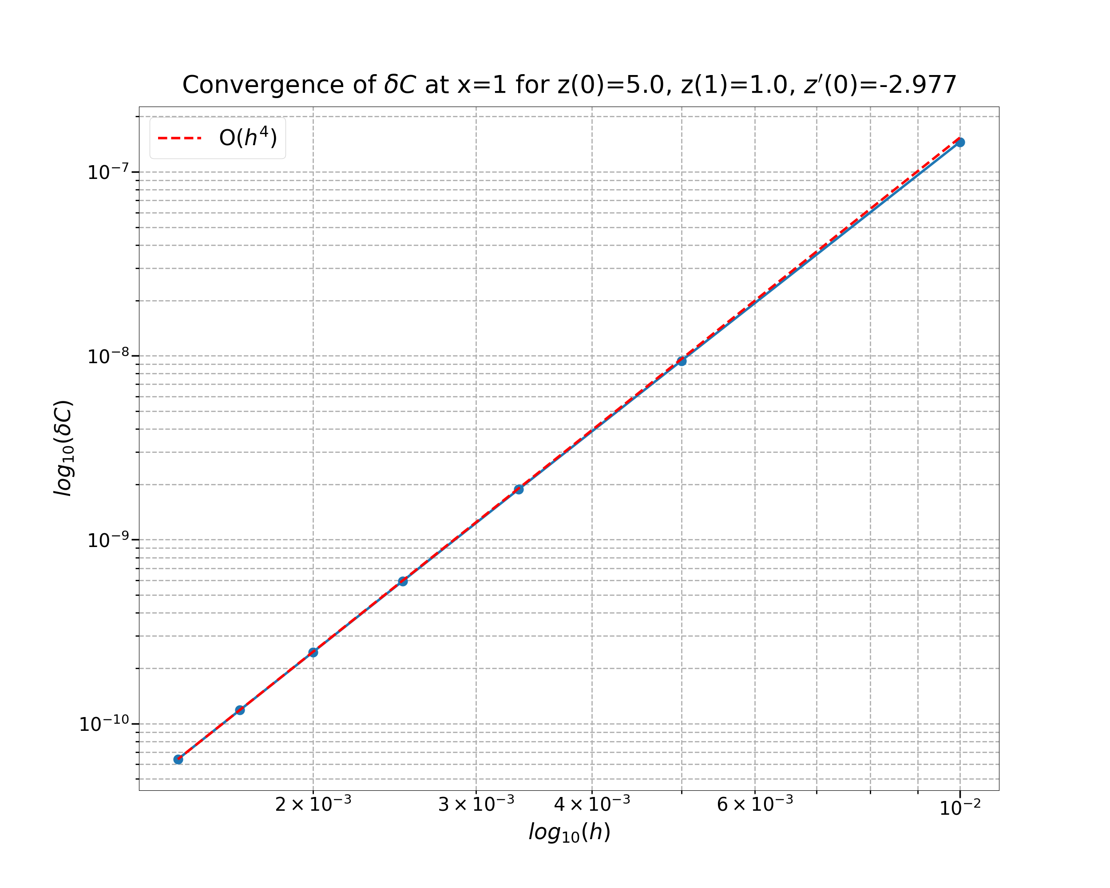
(Preliminary) Results

Slide 6
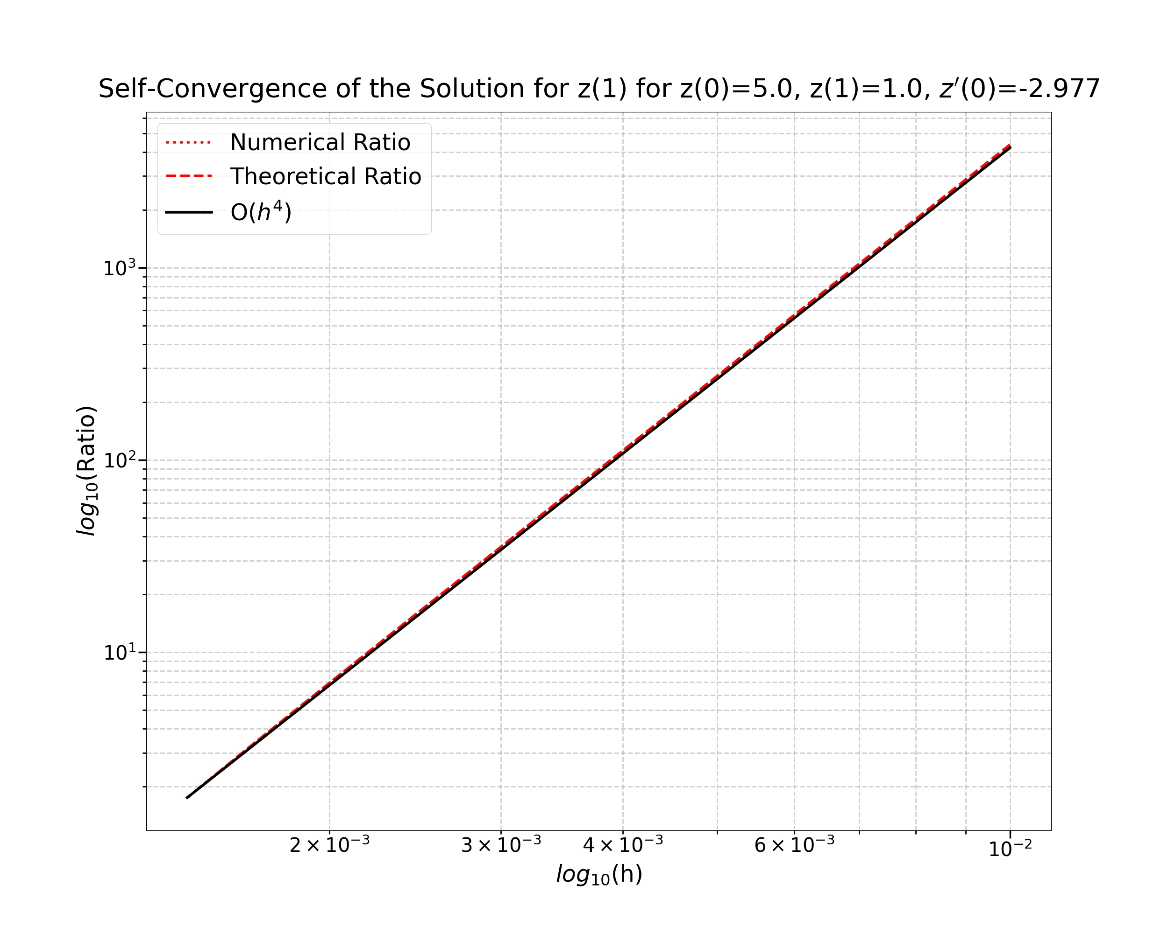
(Preliminary) Results

